Slide 1
Explore Profession-Based Learning with [School/District Name]
[Educator Name]
[Educator Title]
[Educator Contact Info]

Slide 2

What is Profession-Based Learning (Pro-BL)?
Profession-based learning is the highest form of experiential learning – bridging the gap between education and industry.
Industry partners collaborate with local schools to give students real work. These learning and working experiences challenge students to contribute in tangible ways, applying technical and durable skills to produce innovative solutions.

Slide 3
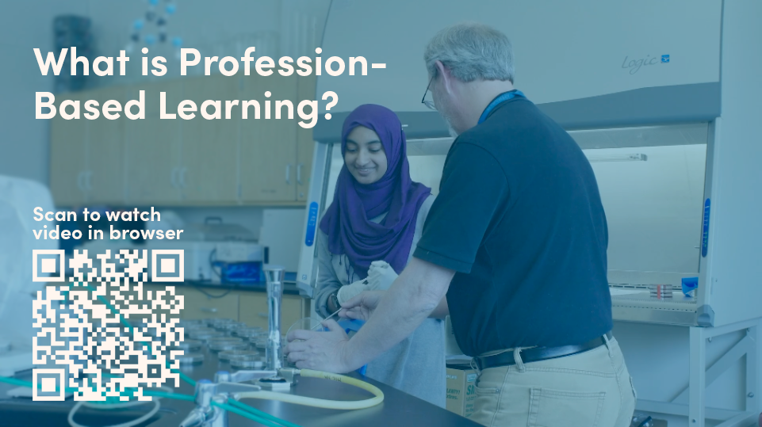

Slide 4
Benefits for Industry
EXPAND YOUR PRODUCTIVITY
INVEST IN THE FUTURE WORKFORCE
STRENGTHEN COMPANY & COMMUNITY TIES
Tackle the “10th task on the to-do list” by engaging students in real work
Hear fresh perspectives and ideas from students, leading to innovative solutions to existing challenges
Gain early access to a pipeline of career-ready future employees
Contribute to the development of durable skills in your upcoming workforce
Give employees the opportunity to mentor students, boosting job satisfaction and retention
Be seen as a leader in workforce development and a positive contributor in the community

Slide 5
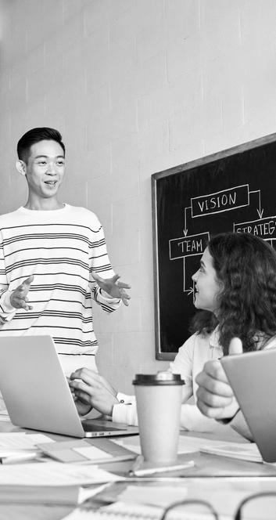
Benefits for Students
Prepares them for college and careers by exposing them to real industry needs and projects
Introduces a variety of career pathways in their community and experiences beyond traditional learning
Readies students to enter the workforce by gaining resume-worthy experience before graduating high school
Expands durable skills including critical thinking, team building and communication
Inspires students to think differently about themselves as learners, collaborators and leaders

Slide 6

Customizable page
Pro-BL Program at
[School/District Name]
Customize this slide with details about your school’s Pro-BL program and offerings. Duplicate slide if more space is needed. Option to replace circular image with school logo.
Point 1
Point 2
Point 3
Point 4

Slide 7

Customizable page – add to or remove options based on what is applicable to your program
Partnering with Pro-BL
REAL-WORLD PROJECTS & INTERNSHIPS
ADVISORY/STEERING COMMITTEE
Expose students to a variety of job options while developing skills in critical thinking, creativity and collaboration
Provide insight in planning our Pro-BL program, leveraging your network and resources to help inform curriculum
MENTORSHIPS
EXTERNSHIPS
Model behavior, answer questions and support students with feedback, insight and inspiration in their areas of interest
Give educators hands-on industry experience, allowing them to learn best practices, build professional relationships and teach students current skills to stay competitive
FUNDING SUPPORT
Can be provided in various forms, such as sponsoring events, donating workspace or classroom space, equipment or software

Slide 8

Customizable page
Ready to explore partnership?
LET’S CONNECT
First Last (Contact 1)
Title
School/District
Email
Phone
First Last (Contact 2)
Title
School/District
Email
Phone
LEARN MORE
Visit experience.work to learn more about Pro-BL, access free resources, hear success stories from other partners and more.
If your school has a webpage with more info about your Pro-BL program, you can include it here – otherwise remove.

Slide 9
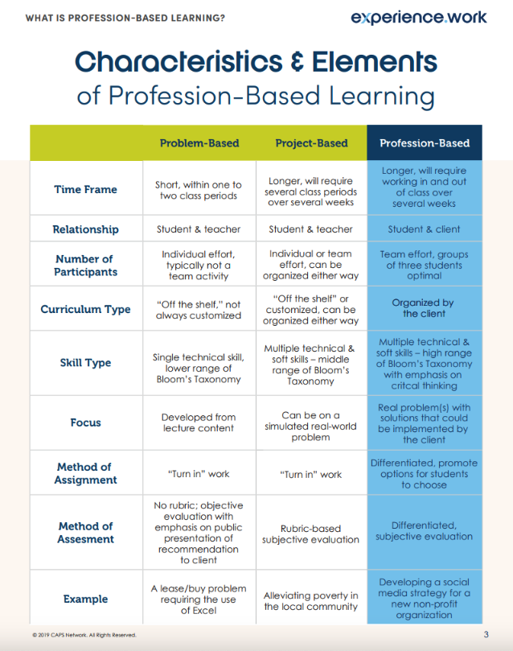
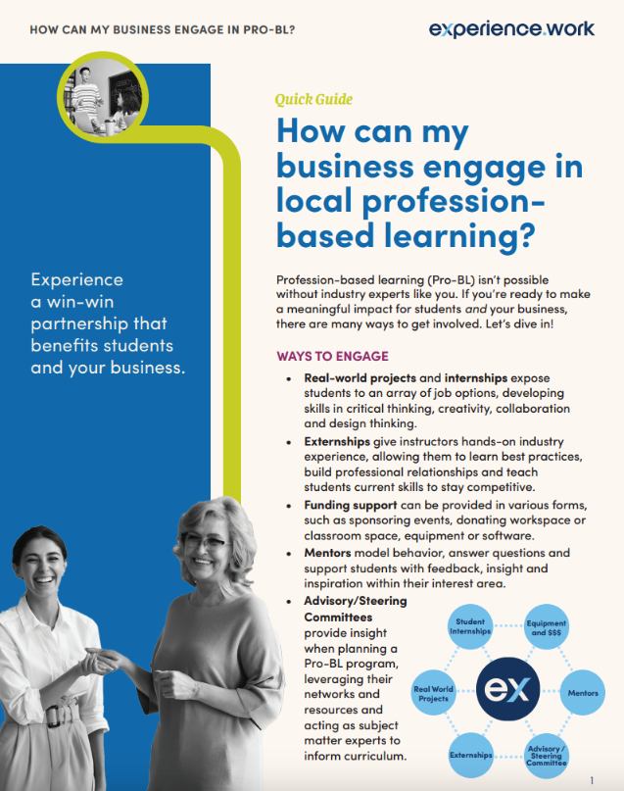
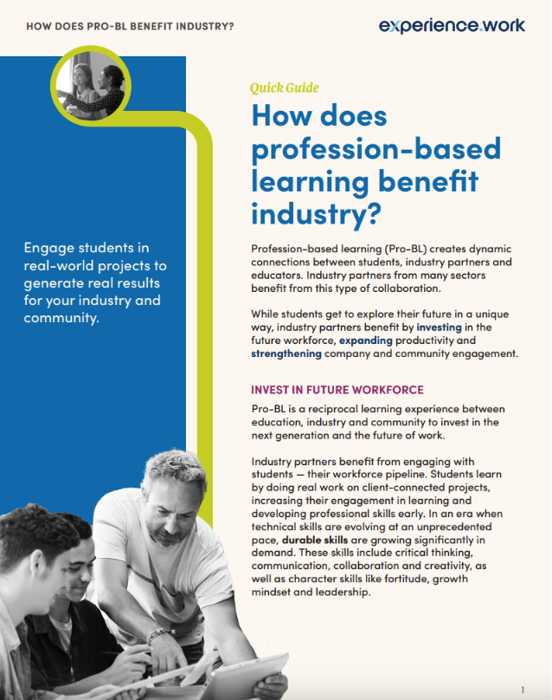
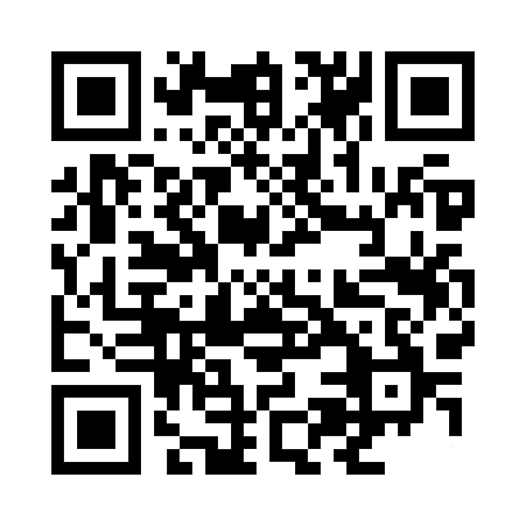
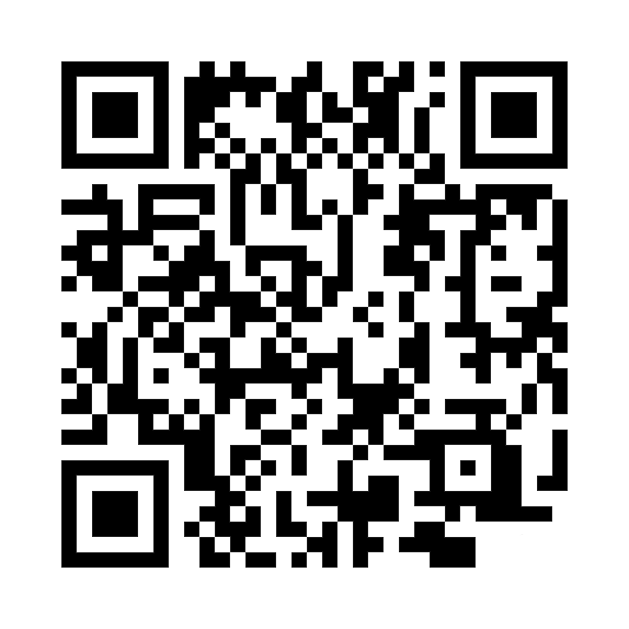
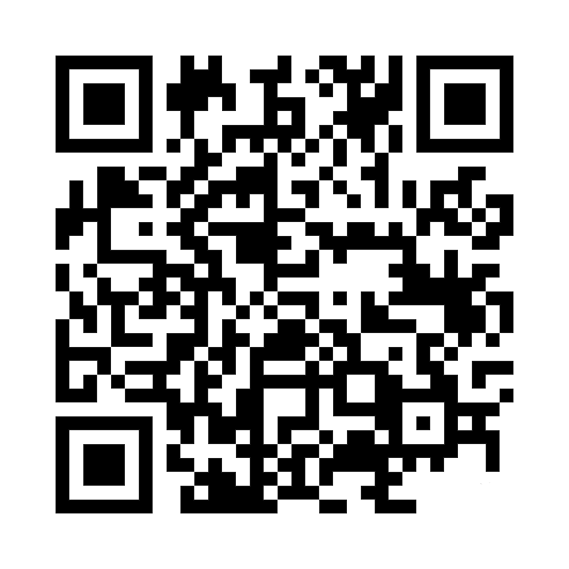
Additional Resources: Quick Guides
What is Pro-BL?
How to Engage in Pro-BL
Benefits of Pro-BL

Slide 10
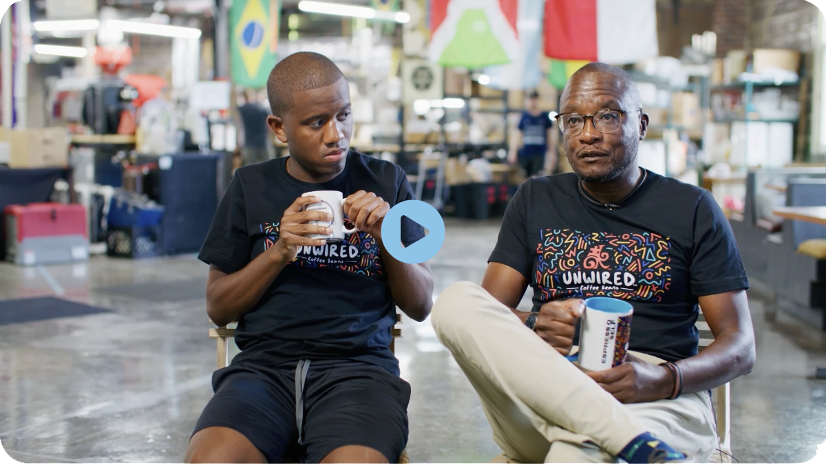
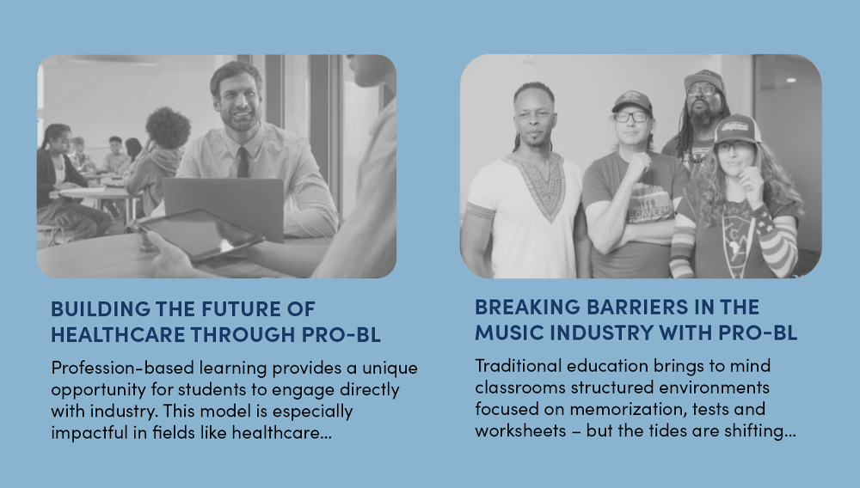
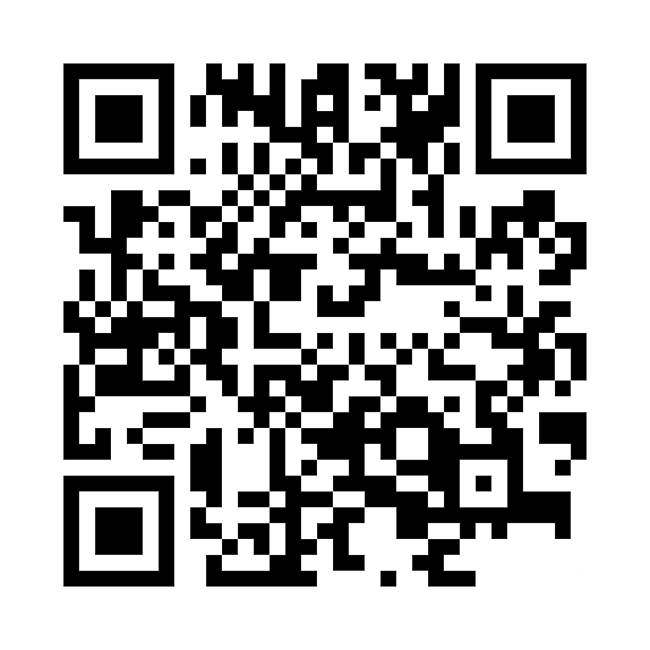
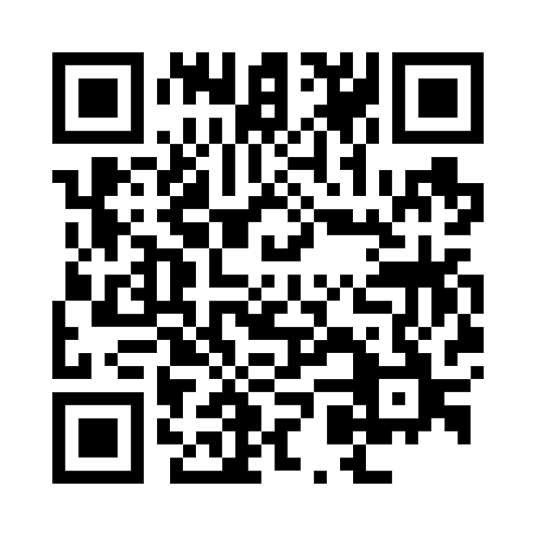
Additional Resources: Videos & Articles
Explore more on profession-based learning through the stories of industry partners, educators and students who have collaborated.
Watch Stories & Testimonials
Read Articles & Case Studies

Slide 11
Engage students in real-world projects to generate real results for your industry and community.
Explore more: experience.work

