Slide 1

Object-Graphs for Context-Aware Category Discovery
Yong Jae Lee and Kristen Grauman
University of Texas at Austin

Slide 2
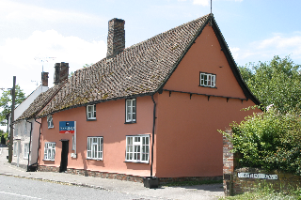

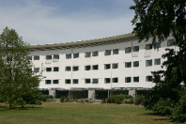
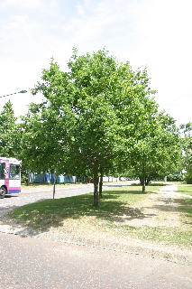
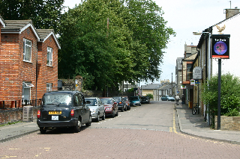
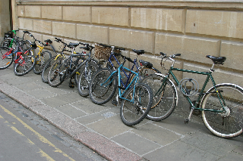
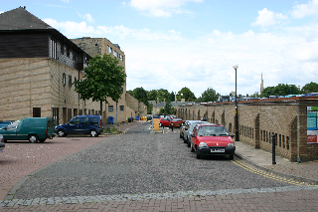
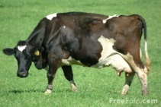

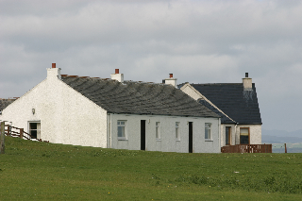
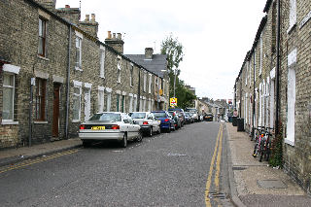
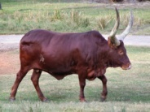

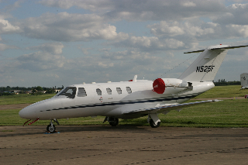
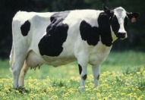
Motivation
Unlabeled Image Data
Discovered categories
1) reveal structure in very large image collections
2) greatly reduce annotation time and effort
3) training data is not always available

Slide 3
Existing approaches
Previous work treats unsupervised visual discovery as an appearance-grouping problem.
- Topic models e.g., pLSA, LDA.
[Fergus et al. 2005], [Sivic et al. 2005], [Quelhas et al. 2005], [Fei-Fei & Perona 2005], [Liu & Chen 2007], [Russell et al. 2006]
- Partitioning of the image data.
[Grauman & Darrell 2006], [Dueck & Frey 2007], [Kim et al. 2008], [Lee & Grauman 2008], [Lee & Grauman 2009]

Slide 4
Existing approaches
Previous work treats unsupervised visual discovery as an appearance-grouping problem.
1
2
3
4
Can you identify the recurring pattern?

Slide 5
Our idea
How can seeing previously learned objects in novel images help to discover new categories?
1
2
3
4
Can you identify the recurring pattern?

Slide 6
Our idea
Discover visual categories within unlabeled images by modeling interactions between the unfamiliar regions and familiar objects.
1
2
3
4
Can you identify the recurring pattern?

Slide 7
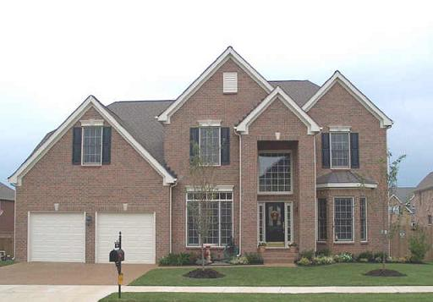
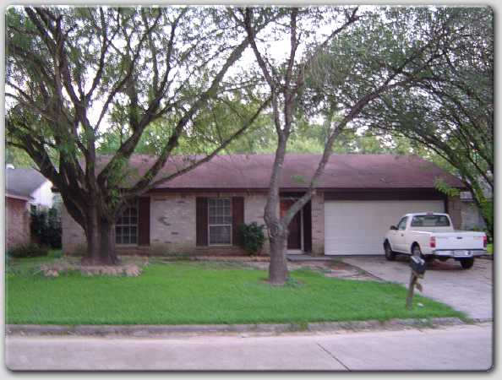
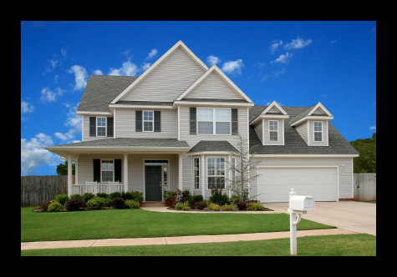

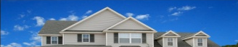


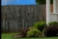






Context-aware visual discovery
?
?
?
sky
sky
sky
house
house
truck
fence
house
drive-way
drive-way
?
grass
grass
?
drive-way
grass
?
Context in supervised recognition:
[Torralba 2003], [Hoiem et al. 2006], [He et al. 2004], [Shotton et al. 2006], [Heitz & Koller 2008], [Rabinovich et al. 2007], [Galleguillos et al. 2008], [Tu 2008], [Parikh et al. 2008], [Gould et al. 2009], [Malisiewicz & Efros 2009], [Lazebnik 2009]

Slide 8
Key Ideas
Context-aware category discovery treating previously learned categories as object-level context.
Object-Graph descriptor to encode surrounding object-level context.
Note: Different from semi-supervised learning – unlabeled data do not necessarily belong to categories of the labeled data.

Slide 9
Approach Overview
Learn category models for some classes
Detect unknowns in unlabeled images
Describe object-level context via
Object-Graph
Group regions to discover new categories

Slide 10
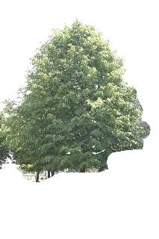
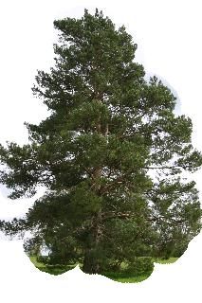
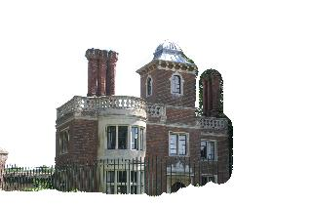
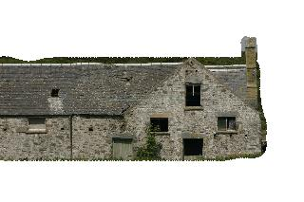
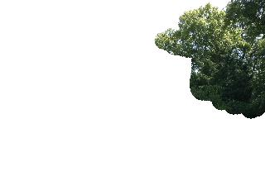
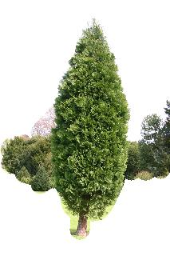
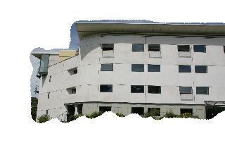
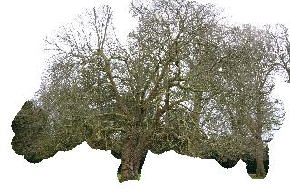
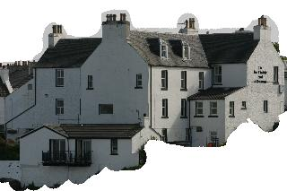

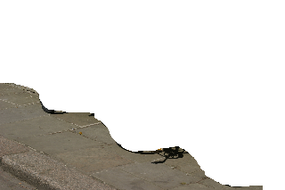





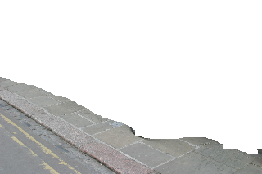



Learn “Known” Categories
Learn Models
Detect Unknowns
Object-level Context
Discovery
tree
building
sky
road
Offline: Train region-based classifiers for N “known” categories using labeled training data.

Slide 11
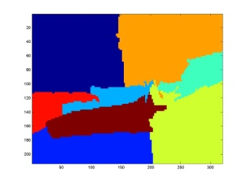
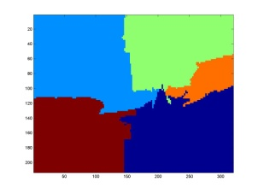
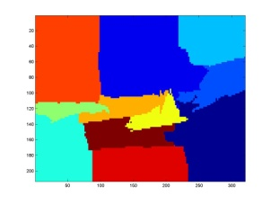
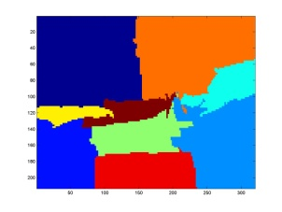
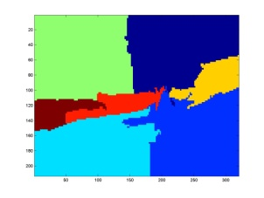
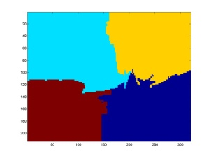
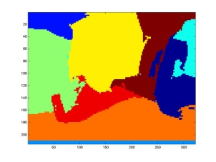
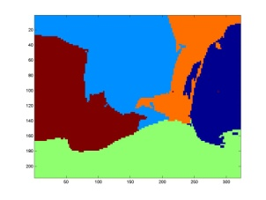
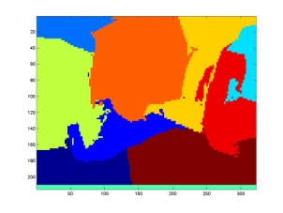
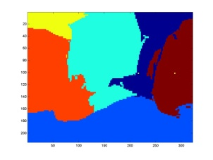
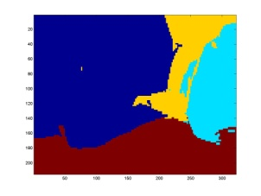
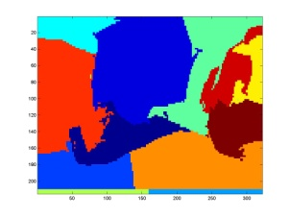
Identifying Unknown Objects
Learn Models
Detect Unknowns
Object-level Context
Discovery
Input: unlabeled pool of novel images
Compute multiple-segmentations for each unlabeled image
e.g., [Hoiem et al. 2006], [Russell et al. 2006], [Rabinovich et al. 2007]

Slide 12
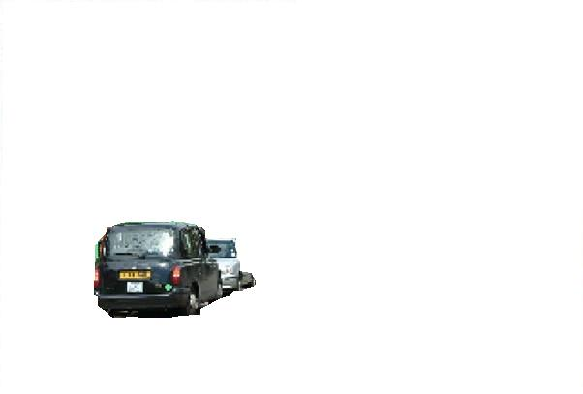
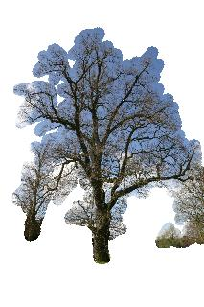
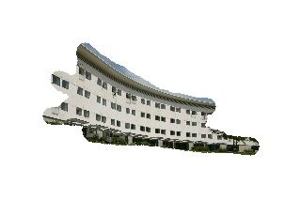
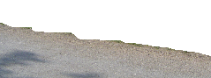
Learn Models
Detect Unknowns
Object-level Context
Discovery
Identifying Unknown Objects
P(class | region)
P(class | region)
Prediction: known
High entropy →
Prediction:unknown
road
road
sky
sky
bldg
tree
bldg
tree
P(class | region)
P(class | region)
Prediction: known
Prediction: known
road
road
sky
sky
bldg
tree
bldg
tree
For all segments, use classifiers to compute posteriors for the N “known” categories.
Deem each segment as “known” or “unknown” based on resulting entropy.

Slide 13
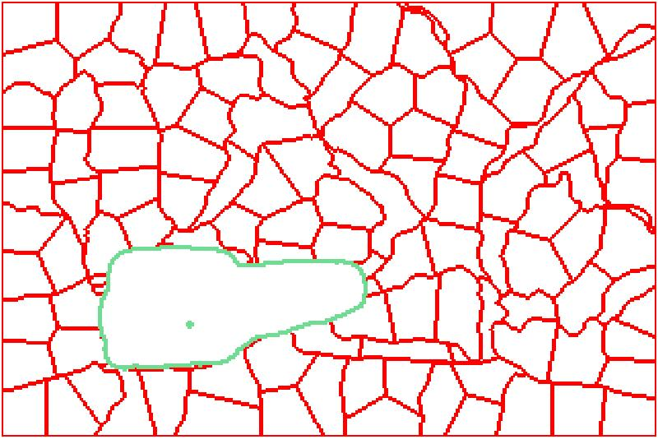
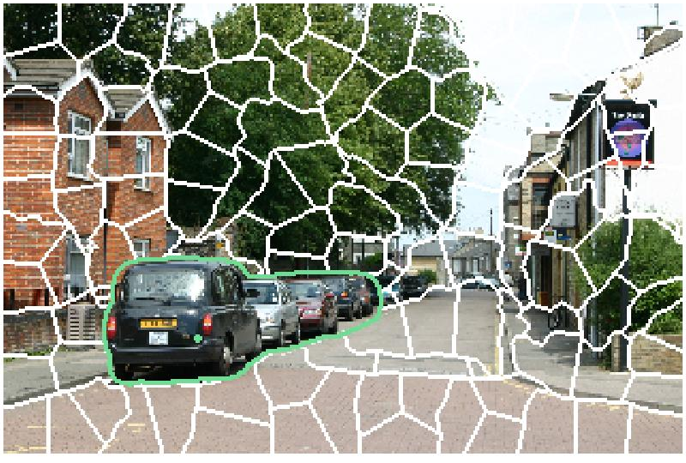
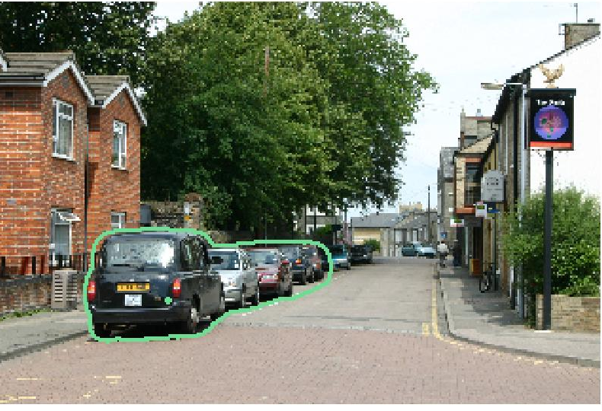
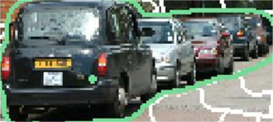
Learn Models
Detect Unknowns
Object-level Context
Discovery
Object-Graphs
An unknown region within an image
0
Model the topology of category predictions relative to the unknown (unfamiliar) region.
Incorporate uncertainty from classifiers.

Slide 14

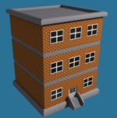
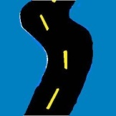

Learn Models
Detect Unknowns
Object-level Context
Discovery
Object-Graphs
An unknown region within an image
Closest nodes in its object-graph
1a
3a
2a
S
3b
1b
2b
0
Consider spatially near regions above and below, record distributions for each known class.
0
self
0
self
1a
above
1b
below
Ra
above
Rb
below
g(s) = [ , , , ]
b t s r
b t s r
b t s r
b t s r
b t s r
b t s r
H₀(s)
H₁(s)
H_{R}(s)
1st nearest region
out to R^{th} nearest

Slide 15














Object-Graphs
Learn Models
Detect Unknowns
Object-level Context
Discovery
Average across segmentations
N posterior prob.’s per pixel
N posterior prob.’s per superpixel
b t s r
b t s r
b t s r
b t s r
Obtain per-pixel measures of class posteriors on larger spatial extents.

Slide 16


Learn Models
Detect Unknowns
Object-level Context
Discovery
Object-Graph matching
Known classes
b: building
t: tree
g: grass
r: road
building / road
building
tree
/ road
building
?
?
road
building
/ road
road
building
/ road
above
below
above
below
above
below
above
below
b t g r
b t g r
b t g r
b t g r
b t g r
b t g r
b t g r
b t g r
g(s₁) = [ : , , : ]
g(s₂) = [ : , , : ]
H₁(s)
H_{R}(s)
H₁(s)
H_{R}(s)
Object-graphs are very similar → produces a strong match

Slide 17

Learn Models
Detect Unknowns
Object-level Context
Discovery
Object-Graph matching
Known classes
b: building
t: tree
g: grass
r: road
building / road
building
building
grass
?
?
road
building
/ road
road
road
above
below
above
below
above
below
above
below
b t g r
b t g r
b t g r
b t g r
b t g r
b t g r
b t g r
b t g r
g(s₁) = [ : , , : ]
g(s₂) = [ : , , : ]
H₁(s)
H_{R}(s)
H₁(s)
H_{R}(s)
Object-graphs are partially similar → produces a fair match

Slide 18





Learn Models
Detect Unknowns
Object-level Context
Discovery
Clusters from region-region affinities
Unknown Regions

Slide 19








































Object Discovery Accuracy
Four datasets
Multiple splits for each dataset; varying categories and number of knowns/unknowns
Train 40% (for known categories), Test 60% of data
Textons, Color histograms, and pHOG Features
MSRC-v2
PASCAL 2008
MSRC-v0
Corel

Slide 20




Object Discovery Accuracy
MSRC-v2
PASCAL 2008
MSRC-v0
Corel

Slide 21

Comparison with State-of-the-art
MSRC-v2
Russell et al., 2006: Topic model (LDA) to discover categories among multiple segmentations using appearance only.
Significant improvement over existing state-of-the-art.

Slide 22






Example Object-Graphs
unknown
building
sky
road
Color in superpixel nodes indicate the predicted known category.

Slide 23




Examples of Discovered Categories

Slide 24











Collect-Cut (poster Thursday)
Unsupervised Segmentation Examples
Discovered Ensemble from Unlabeled Multi-Object Images
Collect-Cut
(ours)
Best Bottom-up
(with multi-segs)
Unlabeled Images
Use discovered shared top-down cues to refine both the segments and discovered categories with an energy function that can be minimized with graph cuts.

Slide 25
Conclusions
Discover new categories in the context of those that have already been directly taught.
Substantial improvement over traditional unsupervised appearance-based methods.
Future work: Continuously expand the object-level context for future discoveries.

Slide 26

Category Retrieval Results

Slide 27

Impact of Known/Unknown Decisions
Red star denotes the cutoff (half of max possible entropy value).
Regions considered for discovery are almost all true unknowns (and vice versa), at some expense of misclassification.

Slide 28












Impact of Object-Graph Descriptor
Appearance-level context
Object-level context
How does the object-graph descriptor compare to a simpler
alternative that directly encodes the surrounding appearance
features?

Slide 29

Perfect Known/Unknown Separation
Performance attainable were we able to perfectly separate segments according to whether they are known or unknown.

Slide 30


Random Splits of Known/Unknown

Slide 31


Identifying Unknown Objects
Learn Models
Detect Unknowns
Object-level Context
Discovery
unknowns
building
tree
knowns
sky
road
Image
GT known/unknown
Multiple-Segmentation Entropy Maps
Previous Work: [Scholkopf 2000], [Markou & Singh 2003], [Weinshall et al. 2008]

