Slide 1
EN.540.635 Software Carpentry Lecture 9 Inheritance | Object-oriented Programming

Slide 2
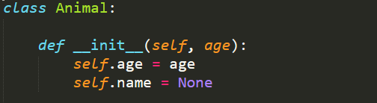
Review: Classes
Class Name
Keyword used to refer to the object itself
Class Initialization Method
Parameters required for
initializing an object
Attributes
All instances of a class have the same names for methods and attributes, but have different values
Example taken from MIT OCW: Introduction to Python
Notes:
Let’s brush up on what we know about classes and objects. Let’s create an example class called animal and then create objects of that class

Slide 3
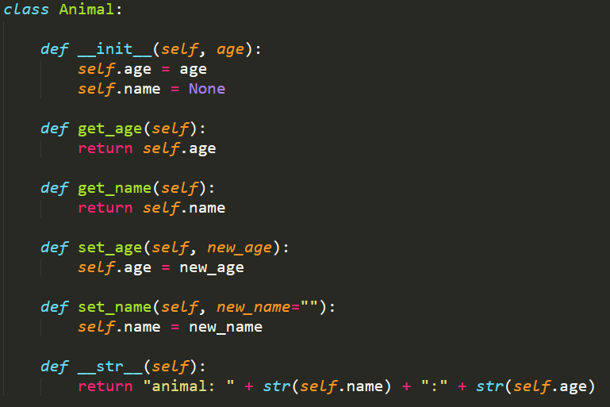
Animal Class
It’s good practice to only modify object attributes using ‘getter’ and ‘setter’ functions, as it sticks to the OOP principle of ‘Encapsulation’
Notes:
Here is the same animal class except here I have fleshed it out a little more. Different from what I was doing in my demo before, I have separate functions that can be used to change the values of the age and name class attributes for any object of this class. This is because it is good practice to interact with the class and any class objects with related methods and not directly changing them.

Slide 4
Inheritance
What if the Animal class was not able to satisfy our requirements?
We want something more specific
The OOP principle of ‘Inheritance’:
Allows us to avoid starting over
Build off of existing code and modify it according to our needs
Notes:
The animal class is very generic and if we want something more specific like a dog and cat class, we could have just started with that, In that case, we would have to create 2 different classes according to the animal. But now that we have an animal class already written, we can use inheritance to create a similar class that starts off already having the code inside the Animal class. And then we can build off of it by adding to it or modifying it according to our needs.

Slide 5
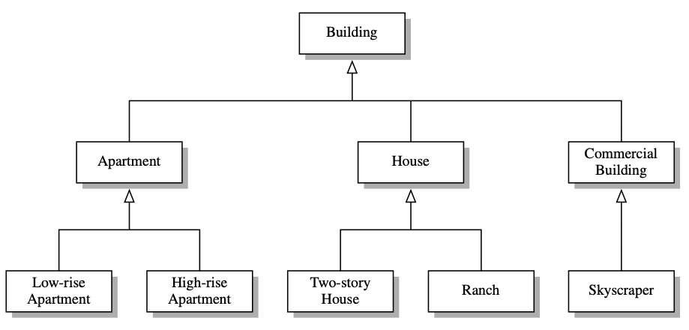
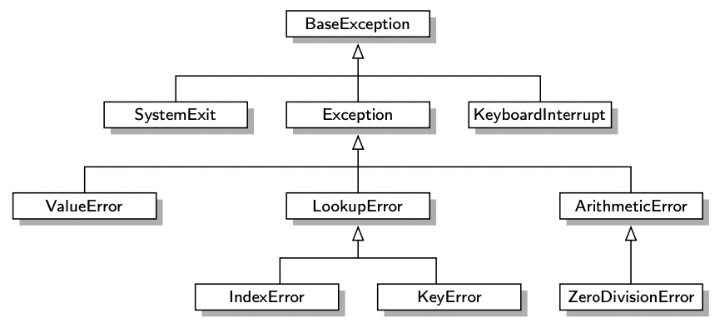
Inheritance
a hierarchical fashion
a level-by-level manner that goes from specific to more general
Example taken from “Data Structures and Algorithms in Python by Michael T. Goodrich, Roberto Tamassia, Michael H. Goldwasser”

Slide 6
Inheritance
Inheritance allows for creating type ‘hierarchies’, in which you can create many different related types that inherit different attributes and methods from their parents
Parent Class: Super class
Child Class: Subclass
By default inherits all attributes and methods
Can be modified to add more attributes and methods
Inherited methods can be overwritten
Animal
Cat
Person
Rabbit
Student
Notes:
We can relate the Inheritance in Computer Science with real world inheritance. You start of with a parent class and then you can build a hierarchy of classes with child classes. These children classes inherit all the attributes and methods by default. Furthermore, you can grandchildren classes and so on and they will inherit everything from all the way back to the original class. Once a child class has been created you don’t have to keep everything from the OG class. You can change the number of class attributes and also change the functionalities of the functions that are inherited. One such

Slide 7
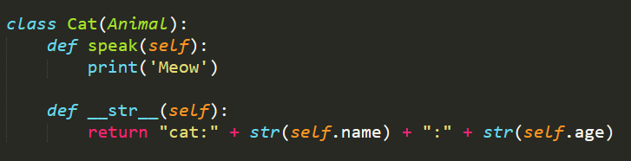
Cat class
The following Class ‘Cat’ inherits all its attributes and methods from the Animal class
Has an additional methods called speak
Overwrites the existing ‘__str__’ method

Slide 8
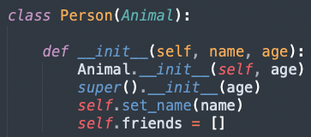
Person class
’__init__’ using super().
The mechanism for calling the inherited constructor relies on the syntax, super().

Slide 9
Access Control in Python
Python does not support formal access control
names beginning with a single underscore are conventionally akin to protected
names beginning with a double underscore (other than special methods) are akin to private
protected (e.g., Java, C++)
Members accessible to subclasses, but not to the general public
private
Members that are declared as private are not accessible to either

Slide 10
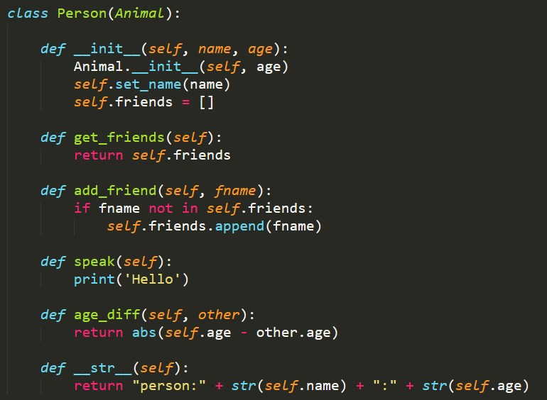
Person class
The Person class also inherits from the Animal class
Makes use of the existing ‘__init__’ function
Has additional attributes and methods
Also modifies the ‘__str__’ function
Instead of explicitly specifying the parent class the ‘super()’ function can also be used

Slide 11
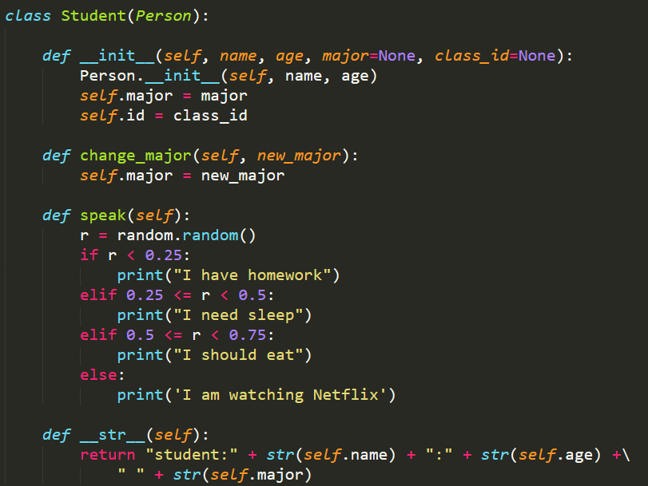
Student class
The Student class inherits from the Person class
You can also use Animal class functions as well, as the Person class inherits from it
You can inherit from multiple different classes as well

Slide 12
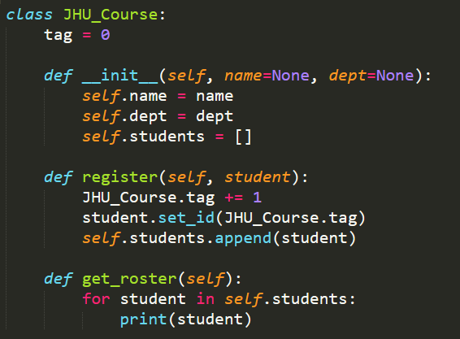
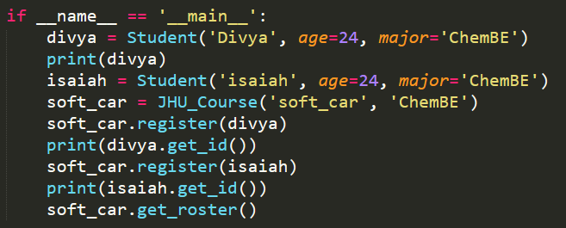
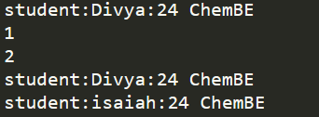
Class Variables

Slide 13
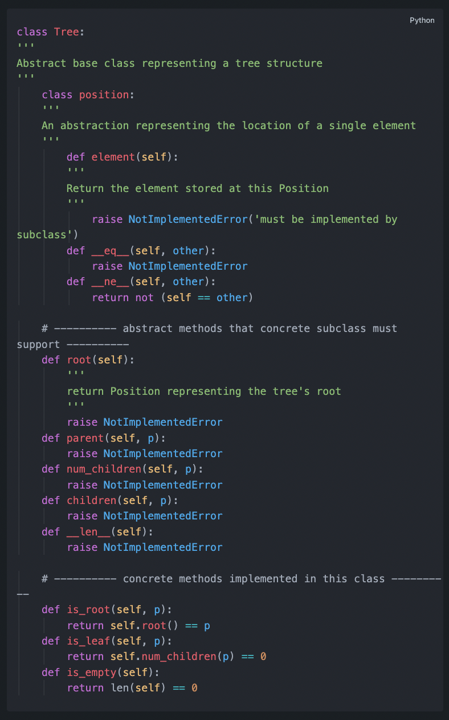
Abstract Base Class (ABC)
Python supports abstract base class (ABC).
An abstract base class *cannot be instantiated* (i.e., you cannot directly create an instance of that class),
but defines common methods that all implementations of the abstraction must have
An ABC is realized by one or more *concrete classes that inherit from the abstract base class* while providing implementations for those method declared by the ABC

