Slide 1
Typical use cases..
I want to set up PostgreSQL on my on-premise.
Can you help me with PostgreSQL configuration best practices?.
Can you help me migrate my Oracle/SQL Server database to PostgreSQL?
I am pushing my data from Source PostgreSQL to Destination with Fivetran's integration and its slow
Can you analyse the possibilities of using pgvector in our environment.
I need multi master at any cost, explore the pitfalls.
I want to migrate my workload from on-premise to AWS Cloud
No..no..Azure., no GCP..You tell me where should I go?

Slide 2
If not, Where should I begin?
Start with on-premise.
Your important files/locations
  postgresql.conf
  binaries location
  datafiles location

Slide 3
Let’s make it simple.,
Architecture – Select/Update statement

Slide 4
Notepad Application
You have your notepad in your hard disk
Double click
It will be fetched to your RAM
And is displayed on your computer screen.
Modify?
You are actually modifying in RAM, when you click on SAVE, it is written to your hard disk (Durable Storage)
abc.txt (RAM)
CPU
abc.txt (Hard disk)

Slide 5
And PostgreSQL is no Exception

Slide 6
Select Statement
[postgres@lab05 ~]$ psql
psql (15.3)
Type "help" for help.
postgres=# select * from emp;
id | sal
----+-----
1 | 100
(1 row)
postgres=#
1 | 100
Backend Process
WAL Writer
1 | 100
Datafile
Control file
WAL file

Slide 7
Durability in ACID
This property ensures that once the transaction has completed execution, the updates and modifications to the database are stored in and written to disk and they persist even if a system failure occurs.
PostgreSQL achieves durability with a concept called Write ahead logging. (WAL Files)
Each transaction you do will be recorded in WAL File

Slide 8
Update statement
postgres=# begin;
BEGIN
postgres=*# select txid_current();
txid_current
--------------
755
(1 row)
postgres=*# update emp set sal=200 where id=1;
UPDATE 1 ##data modified in RAM
postgres=*#
postgres=*# commit;
COMMIT ##data written to WAL
postgres=#
postgres=# select xmin, * from emp;
xmin | id | sal
------+----+-----
755 | 1 | 200
(1 row)
postgres=#
755 | 1|200
755 | 1 |200
bgwriter
WAL Writer
754|1 | 100
754
755 | 1 |200
Datafile
Control file
WAL file

Slide 9
Update statement
postgres=# begin;
BEGIN
postgres=*# select txid_current();
txid_current
--------------
755
(1 row)
postgres=*# update emp set sal=200 where id=1;
UPDATE 1 ##data modified in RAM
postgres=*#
postgres=*# commit;
COMMIT ##data written to WAL
postgres=#
postgres=# select xmin, * from emp;
xmin | id | sal
------+----+-----
755 | 1 | 200
(1 row)
postgres=#
755 | 1|200
755 | 1 |200
bgwriter
WAL Writer
754| 1|100 (AV) 755|1 |200
754 #before checkpoint
755 #after checkpoint
755 | 1 |200
Datafile
Control file
WAL file

Slide 10
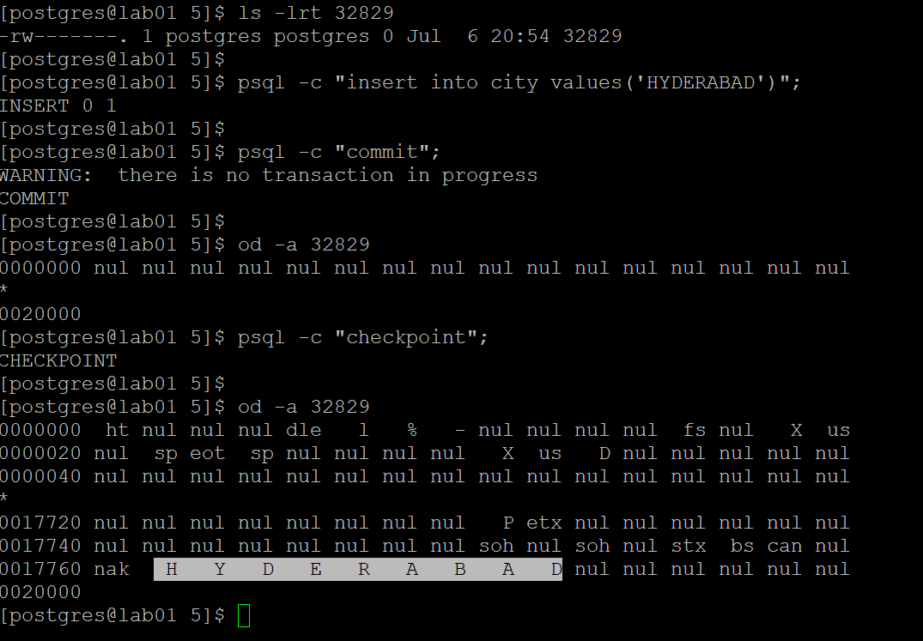
How can I confirm that the data is written to disk?

Slide 11
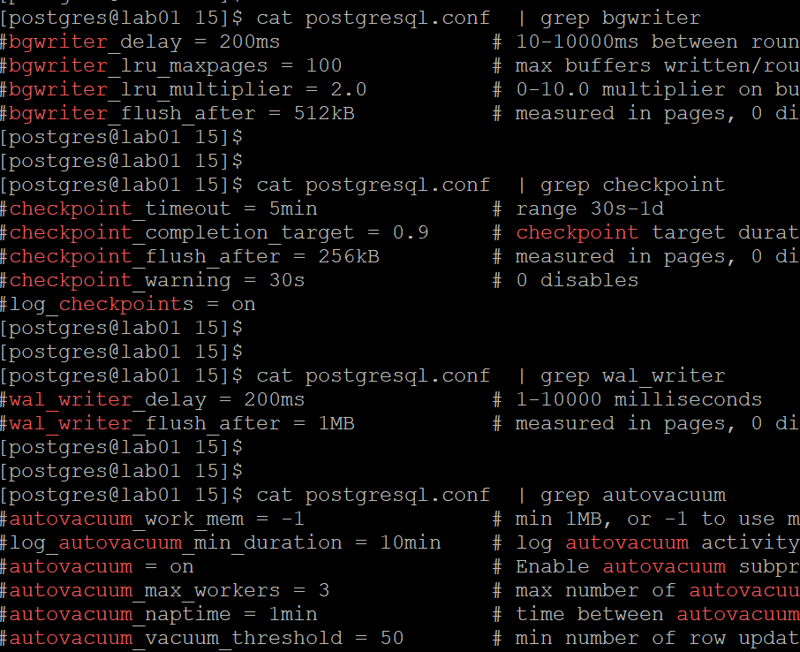
Can I control the activity?
755 | 1|200
755 | 1 |200
bgwriter
WAL Writer
754| 1|100 (AV) 755|1 |200
754 #before checkpoint
755 #after checkpoint
755 | 1 |200
Datafile
Control file
WAL file

Slide 12
See everything… possible.,

Slide 13
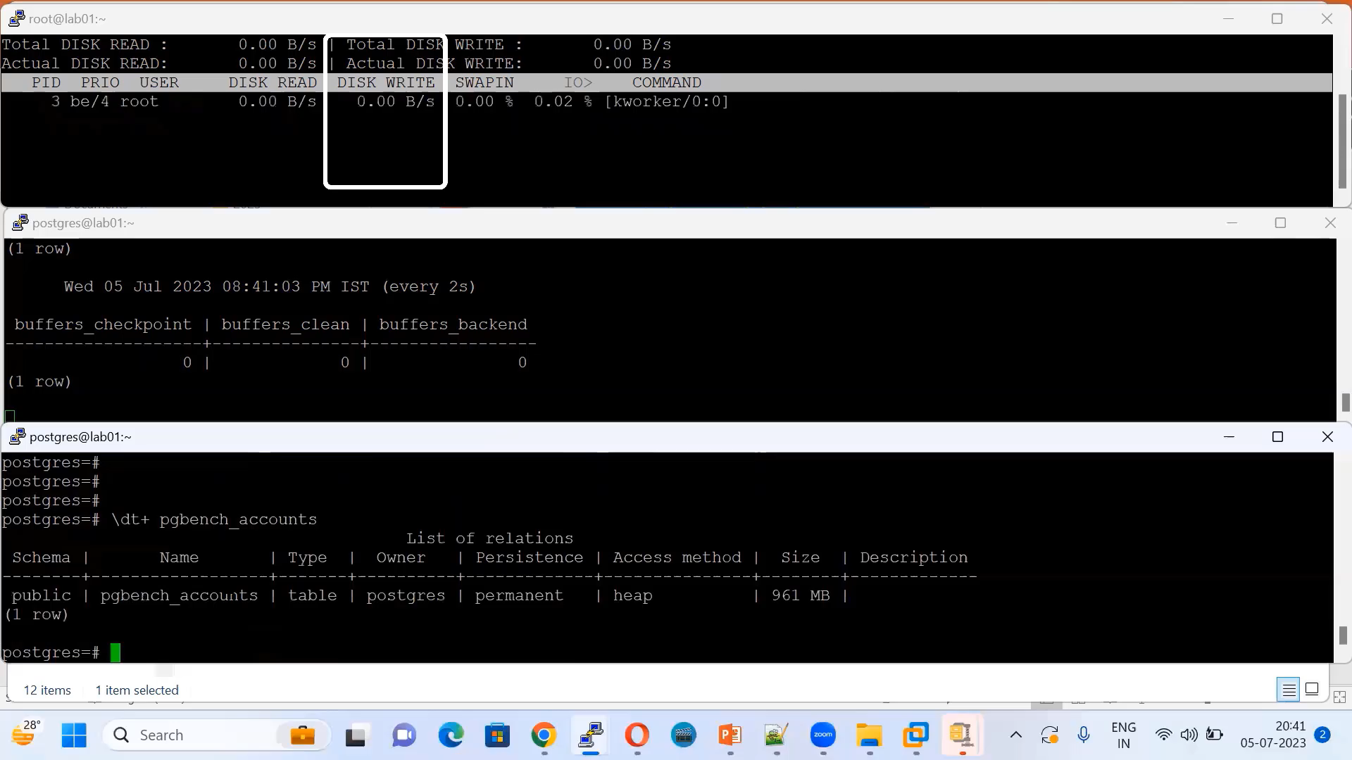
Update statement

Slide 14
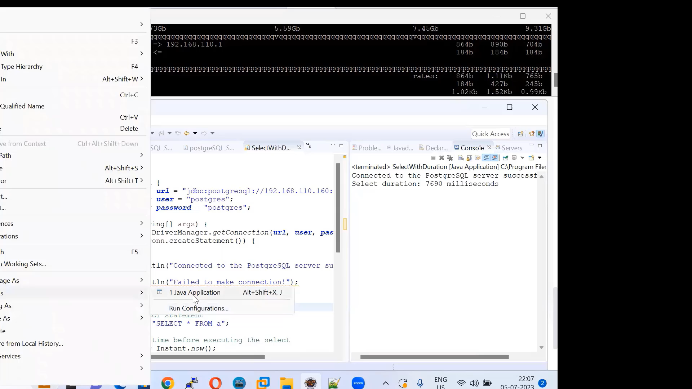
Application

Slide 15
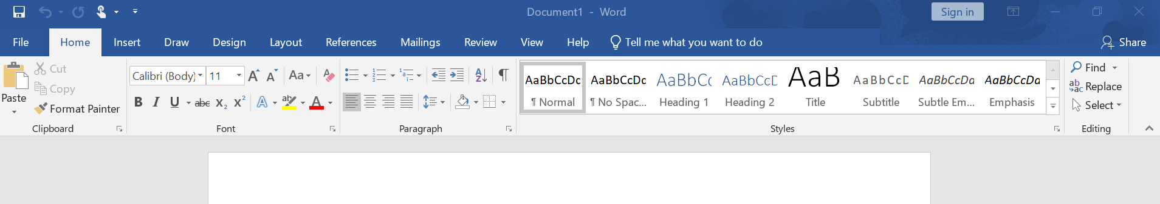
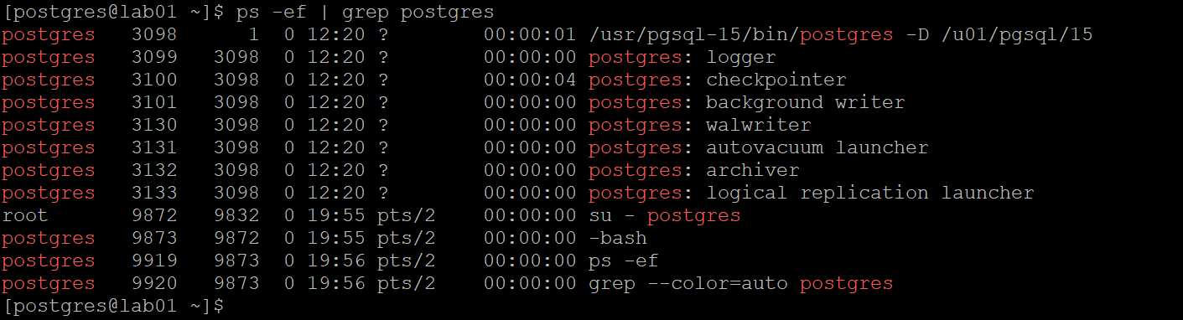
Again.. If not, Where should I begin?
Your important files/locations
Breakdown and simplify..
  postgresql.conf
  binaries location
  datafiles location

Slide 16
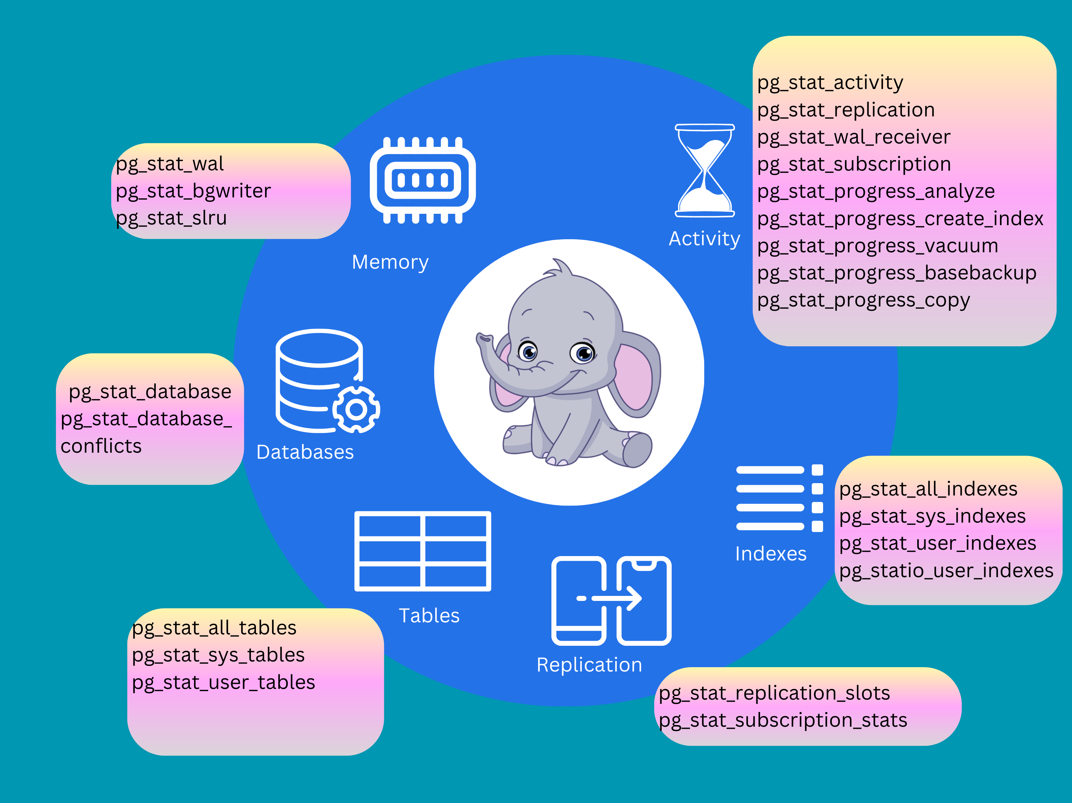
Statistics views

Slide 17
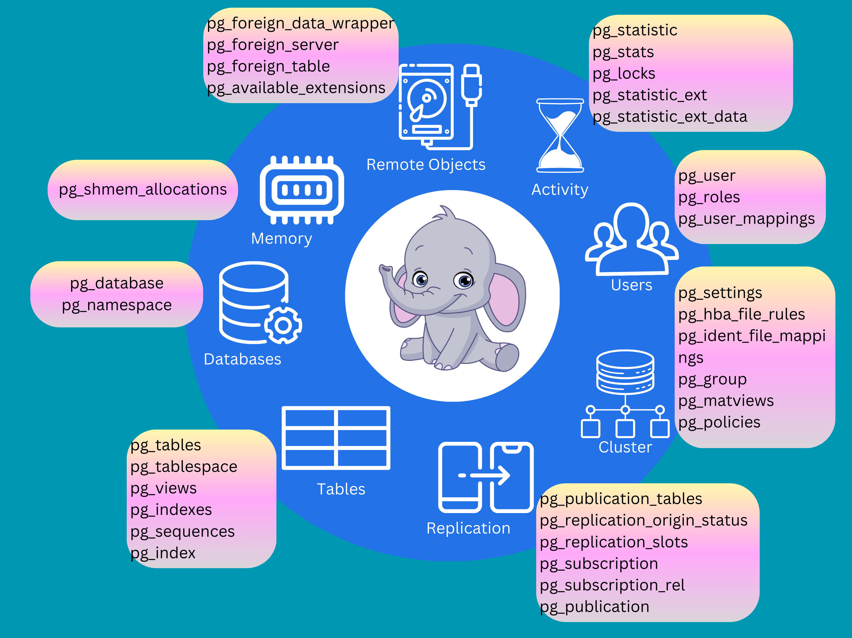
System Catalogs

Slide 18
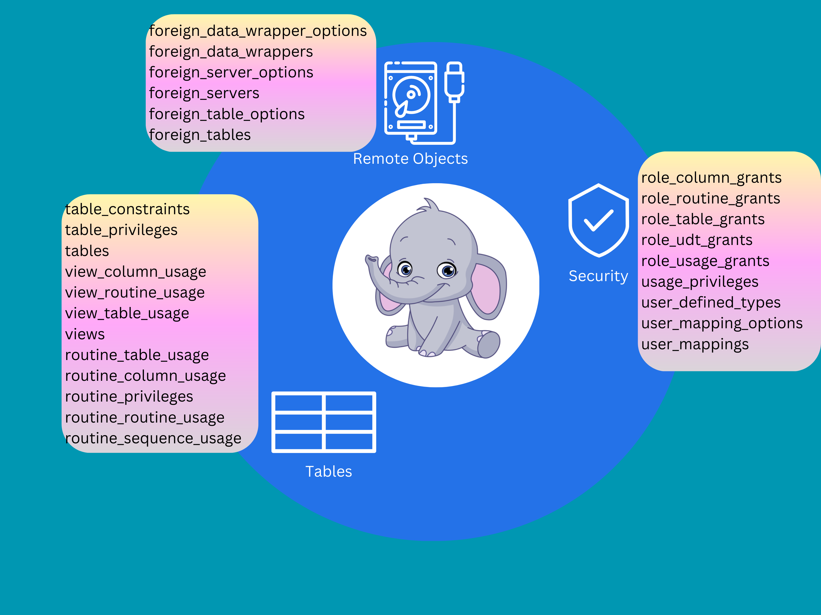
Information schema

Slide 19
What’s Next - Roadmap?
https://roadmap.sh/postgresql-dba
https://github.com/dhamaniasad/awesome-postgres

Slide 20
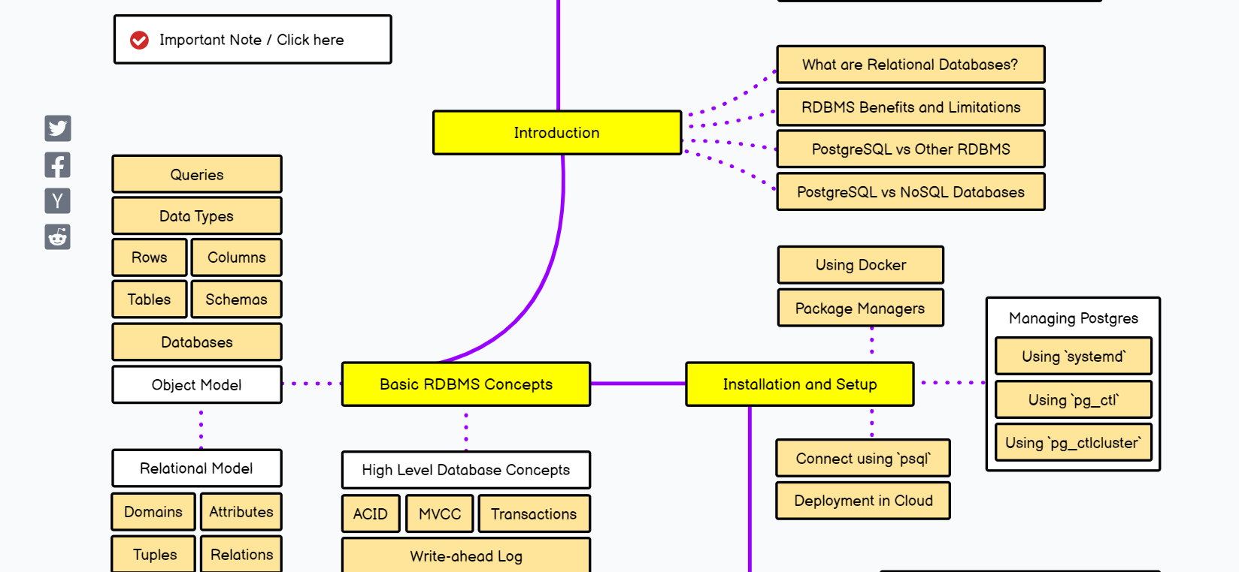
Excerpt

Slide 21
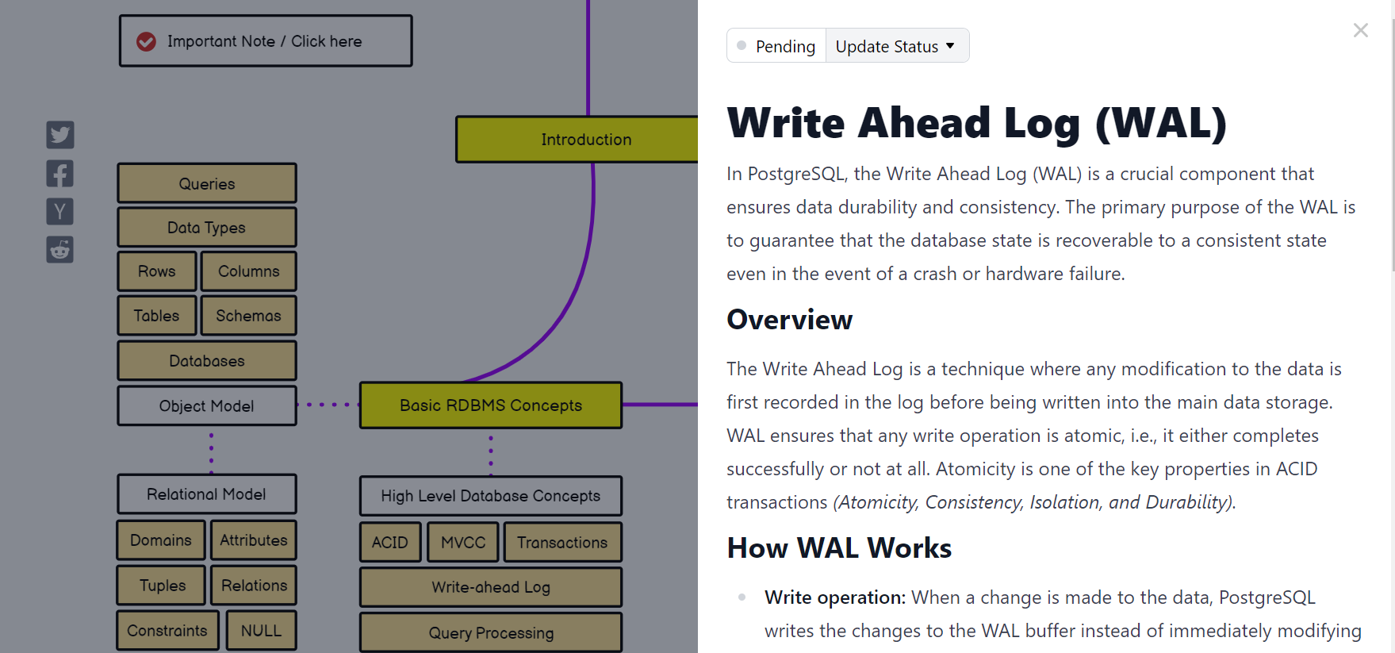
Detailed

Slide 22
Resources
Source code
https://doxygen.postgresql.org/
From PostgreSQL
https://pgpedia.info
https://en.wikipedia.org/wiki/PostgreSQL
https://www.postgresql.org/list/pgsql-admin/2023-07/
Git-blog
https://github-com.translate.goog/digoal/blog/tree/master/class?_x_tr_sl=auto&_x_tr_tl=en&_x_tr_hl=en&_x_tr_pto=nui
Blog it - Write your own content
https://postgreshelp.com/postgresql-checksum/

Slide 23
Resources - Contd..
Almost all blogs of derived product vendors., e.g.,
https://www.pgedge.com/blog/
https://pgdash.io/blog/index.html
https://www.enterprisedb.com/blog
https://github.com/**
https://habr.com/en/hub/postgresql/
https://www.depesz.com/2013/04/27/explaining-the-unexplainable-part-2/
Conferences
Ask Google

Slide 24
Resources - Books..
Mandatory
  PostgreSQL 14 Administration cookbook – Simon Riggs , Gianni Ciolli
  PostgreSQL 13 Cookbook - Vallarapu Naga Avinash Kumar
  Troubleshooting PostgreSQL - Hans-Jürgen Schönig
Basic SQL and Administration
  Learning PostgreSQL - Salahaldin Juba
  Learn PostgreSQL - Luca Ferrari
  The art of PostgreSQL - Dimitri Fontaine

Slide 25
Resources - Books..
High Availability
  PostgreSQL High Availability Cookbook - Shaun M. Thomas
AWS and Cloud
  Beginning PostgreSQL on the Cloud - Baji Shaik
  Oracle to Aurora PostgreSQL Migration Playbook - AWS Guide
  Amazon aurora labs for PostgreSQL - AWS
Application Tuning
  PostgreSQL Query Optimization - Henrietta Dombrovskaya
OS and Database Tuning
  PostgreSQL 9.6 High Performance - Ibrar Ahmed

Slide 26
Conclusion
Go home, get your hands dirty with pglogical
Go home, ask ChatGPT to write a python code to do bulk or batch data load into your database or ask to write a code to insert embeddings into your vector database
Go home, ping the person you made friend here.
Get yourself ready with the content before it gets asked for.

Slide 27
Thank you &
Questions ??

